Slide 1
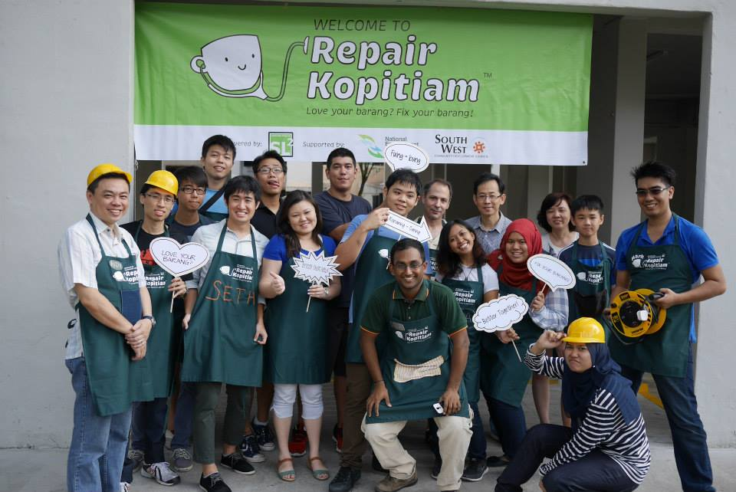
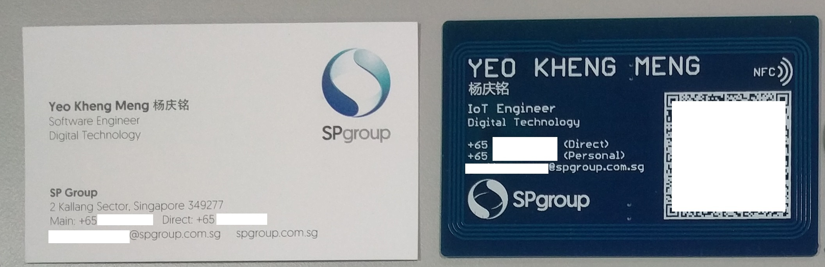
About myself
Volunteered in RK since Mar 2015
2015 NUS Computer Science
IoT Engineer
Singapore Power Digital Technology (since Sept 2016)
RK #2: 8 Mar 2015 @ Blk 425 Jurong West

